Slide 1

Introduction to Mobile Development with Xamarin
Matthew Leibowitz
Software Engineer @ Microsoft
@mattleibow
maleib@microsoft.com

Slide 2
Agenda
What is Xamarin?
Xamarin & .NET
Under the Hood
Tooling & Integrations
Xamarin in Visual Studio

Slide 3

Integrations
Notes:
There is a lot more to Xamarin and .NET as there is a wonderful ecosystem that has built up around it over the years.

Slide 4
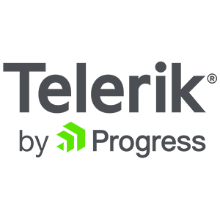
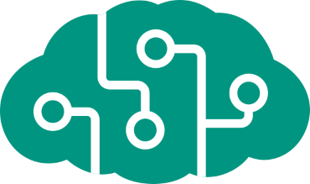










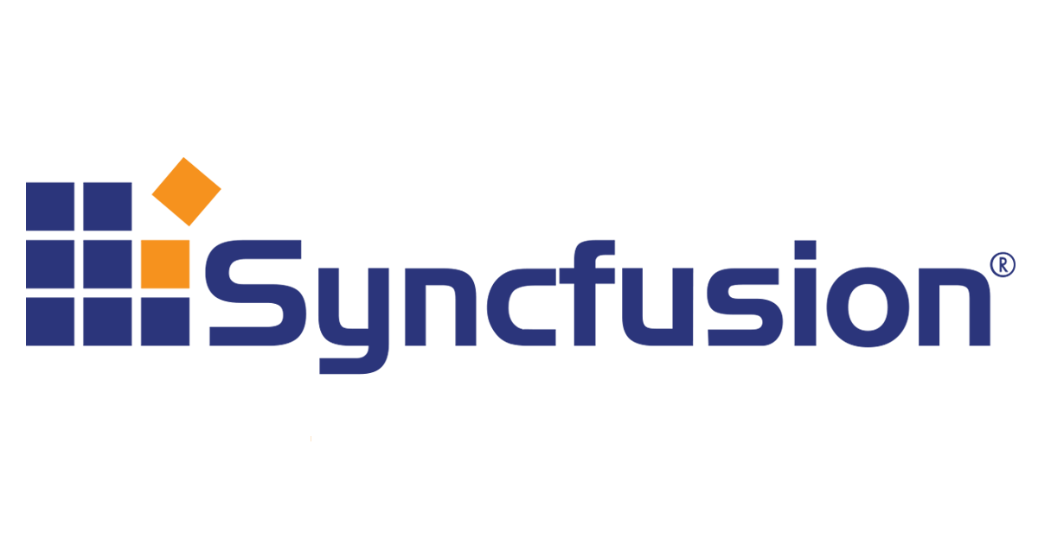

Libraries & Tools
Cognitive
Services
Azure Active
Directory B2C
Zxing
Barcode
Scanning
Akavache
Gorilla
Player
Zeplin
Notes:
First is libraries, essentially giving you anything that you need.

Slide 5
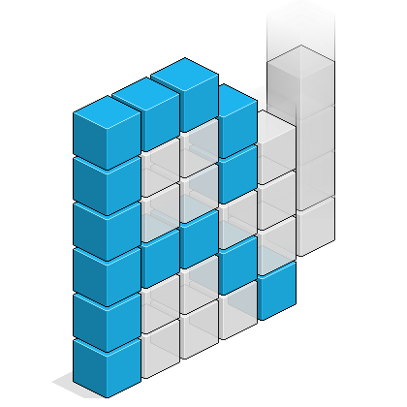

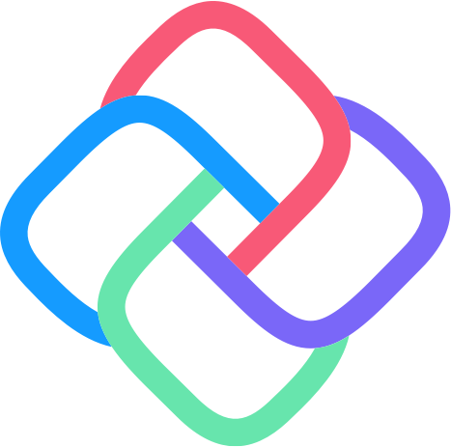


Frameworks
MVVMCross
Uno
ReactiveUI
Reactive Extensions
Notes:
There have even been specific frameworks for architecture and UI that have become industry standards.

Slide 6
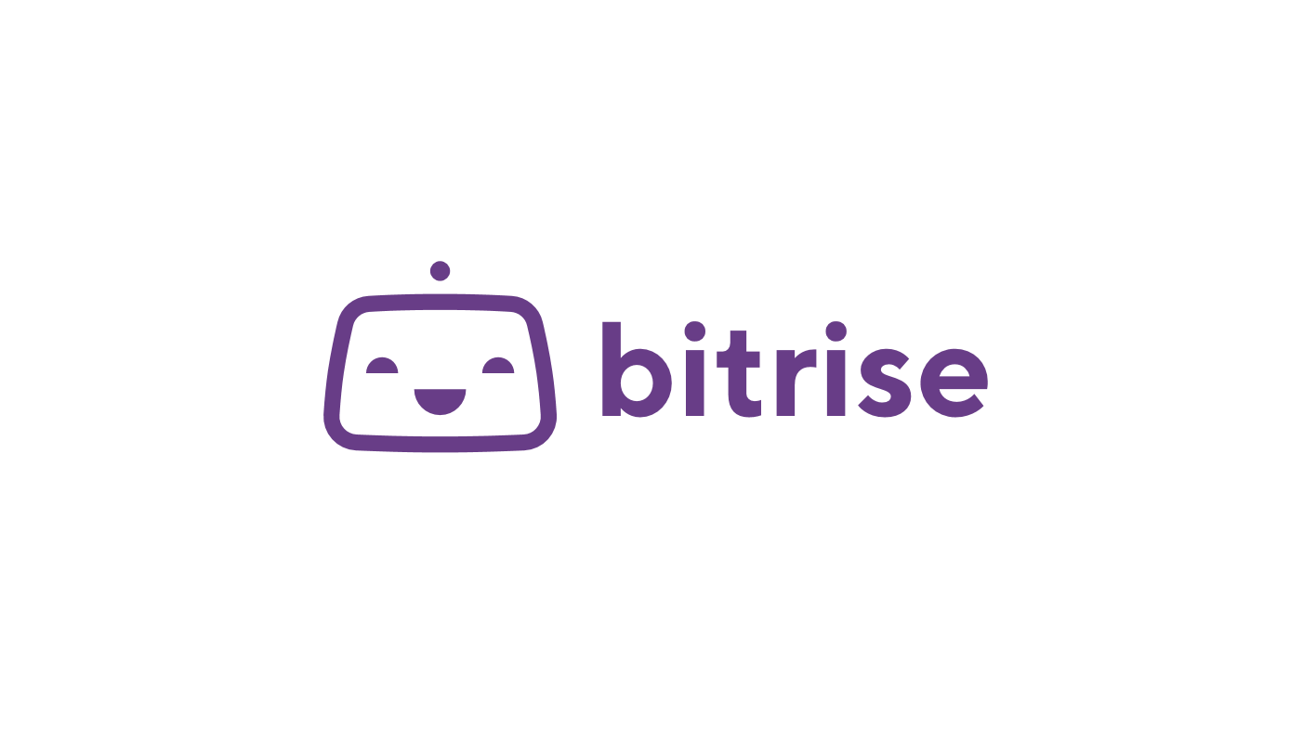
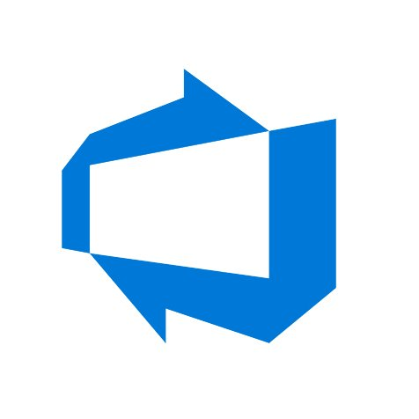
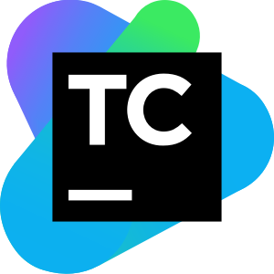

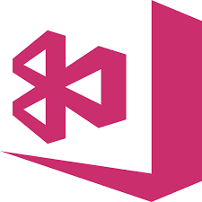
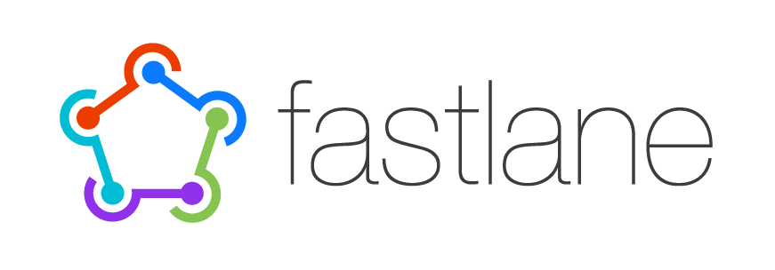
Continuous Integration & Delivery
Azure
Devops
Team
City
App
Center
Jenkins
Notes:
Not only does Xamarin work great with DevOps tools from Microsoft, but any CI and CD system out there.

Slide 7




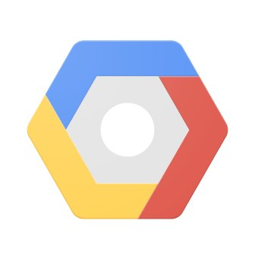

Intelligent Clouds
IBM
MobileFirst
Firebase
Google
Cloud
Platform
Realm
Notes:
If you need a backend, Xamarin is open and you can use anything you desire.

Slide 8
Notes:
Naturally Xamarin and .NET apps work absolutely amazing for cloud apps with Microsoft Azure.

Slide 9
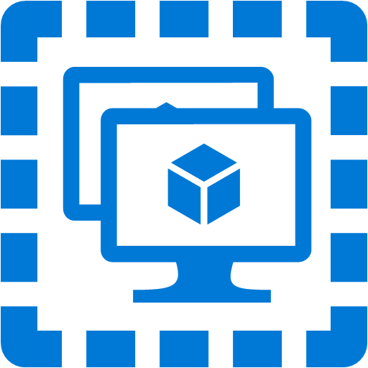
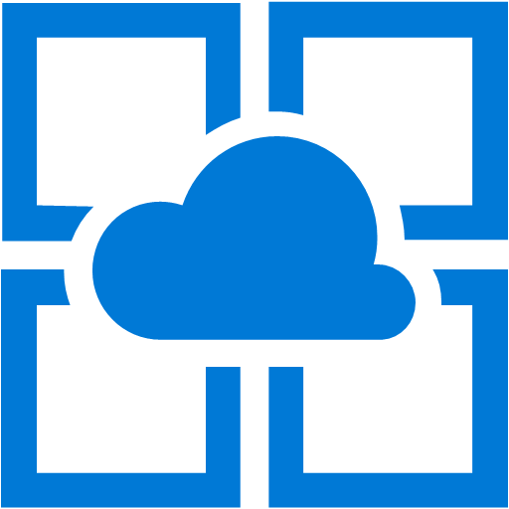
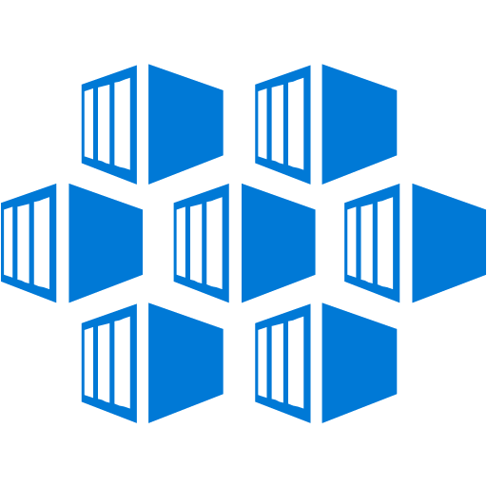
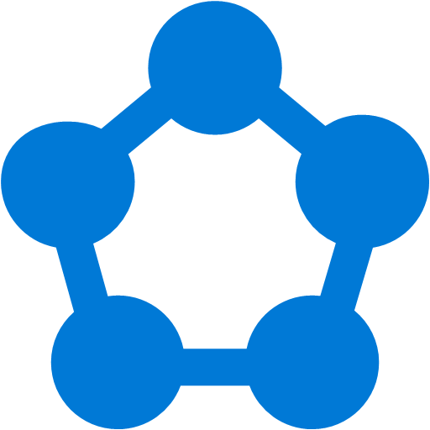






.NET cloud apps run best in Azure
Azure Storage
Azure Cosmos DB
Azure App Service
Azure Functions
Azure App Insights
Azure Service Fabric
Azure SignalR Service
Azure Virtual Machines
Azure SQL Database
Azure Cognitive Services
Azure Kubernetes Service (AKS)
And many more…
Extend apps with serverless, event driven tasks
Commoditized AI
Fully managed platform perfect for running .NET Framework and .NET Core web apps and services
Application performance and usability monitoring
Build native .NET, fully managed, scalable microservices
Relational Database
Non-Relational Database
Fully managed real-time web functions, like chat, gaming, tickers, collaboration and more
Store anything. Great for binaries
Container orchestrator for Linux workloads (.NET Core)
Notes:
No matter what you may need, there is a service in Azure for you. From serverless compute with Functions to realtime communication with SignalR, or databases with SQL and Cosmos DB there are great cross-platform SDKs for .NET.

Slide 10
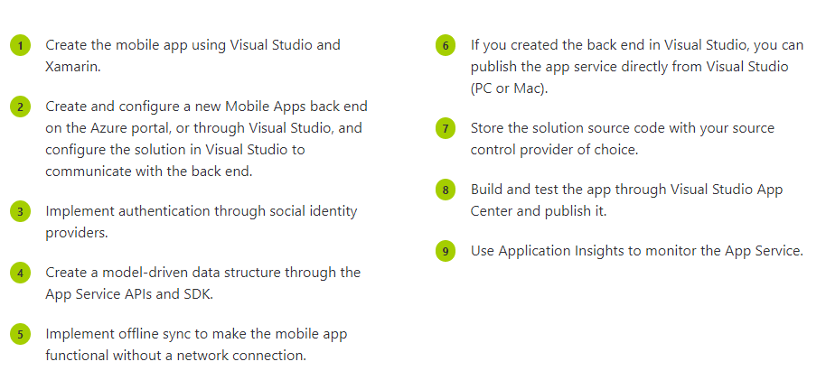
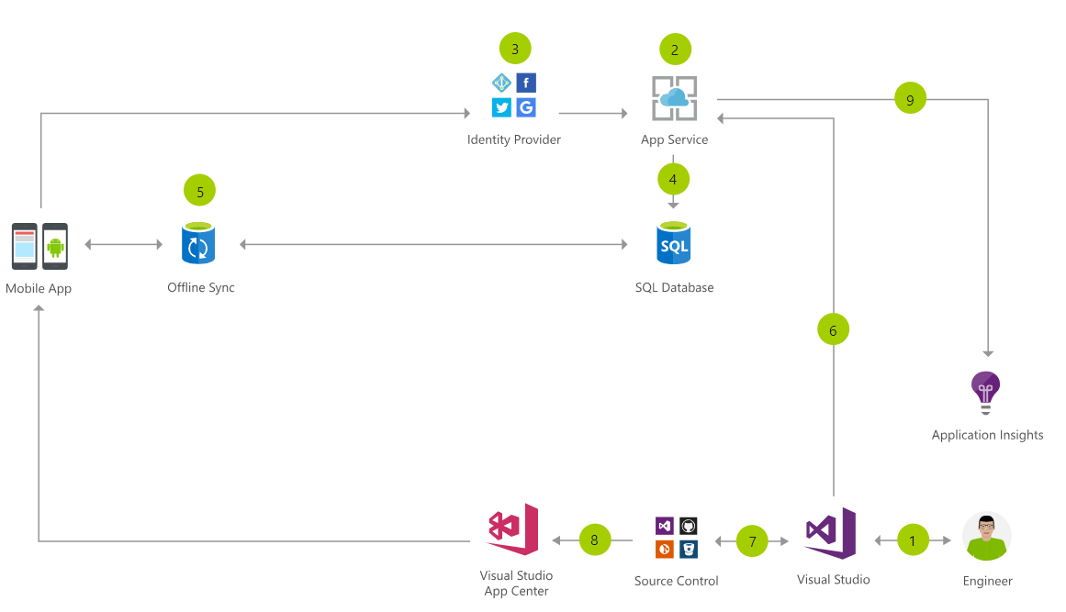
Cloud Mobile App Architecture
Notes:
Here is an example of what a cloud mobile app may look like.
You have your app, with identity providers with Azure AD B2C, and app service talking to SQLite and a sync later using App Service. You can export all of your data into App Insights and continuously monitor and ship with Azure DevOps and App Center.

Slide 11
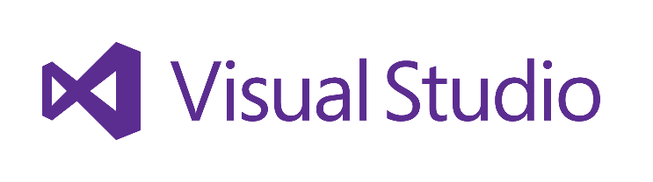
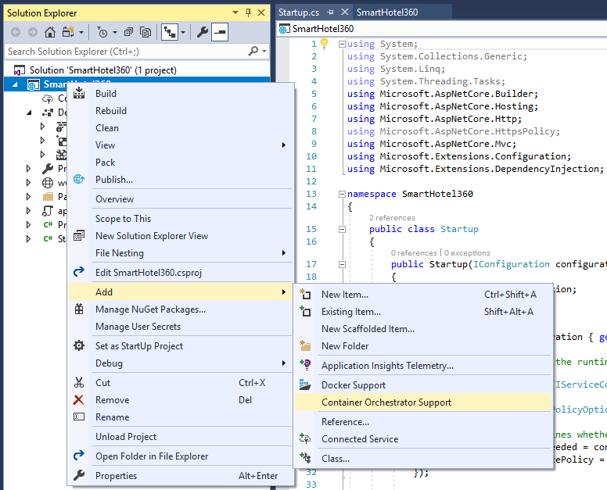
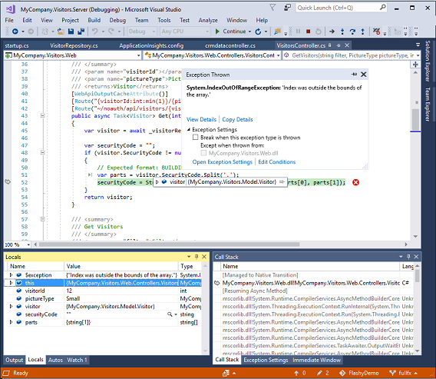
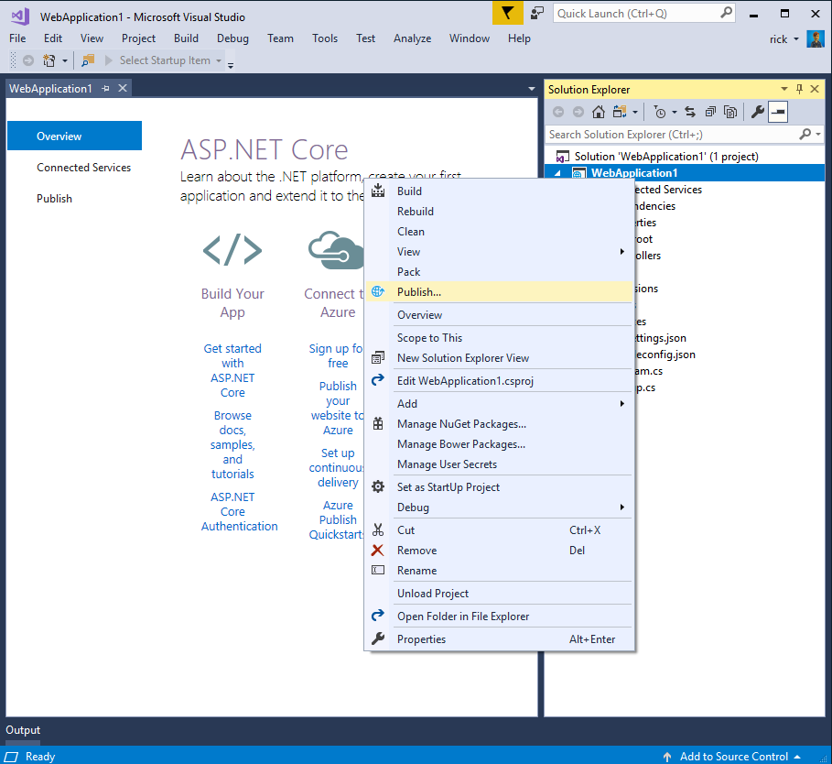
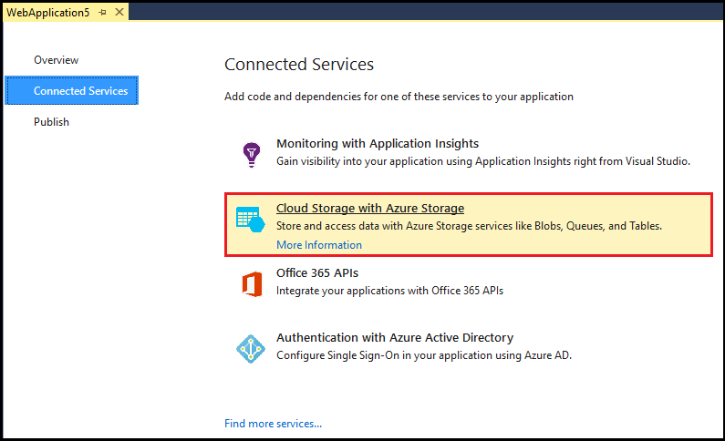
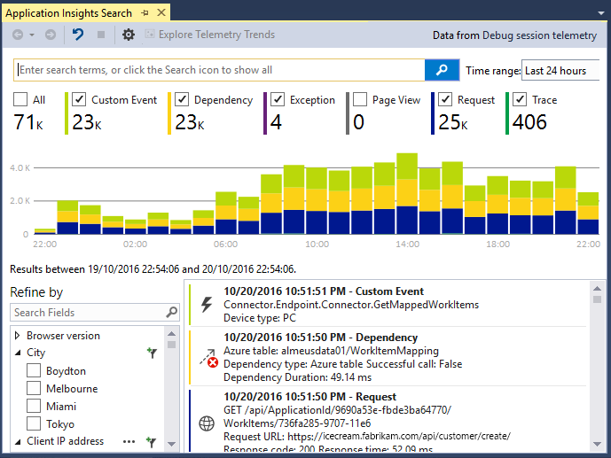
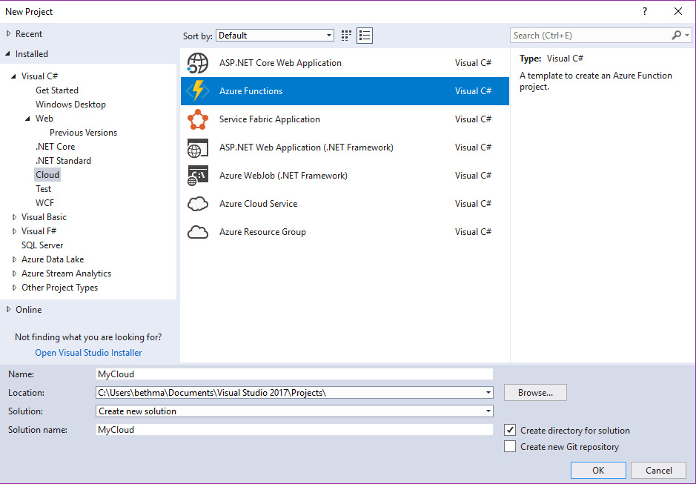
Accelerate your
development
cloud
Seamless Azure Integration
Publish directly to Azure without leaving the IDE
Connected Services
A new experience for easily discovering and extending your app with cloud services
Container Tools
Quickly add Docker compose and container orchestrator support to your apps
App Insights with Code Lens
Get a 360° view of your app that includes availability, performance and user behavior
Azure Functions
Get started quickly with serverless using templates and tools for development and debugging
Snapshot Debugging
Production debugging your cloud apps has never been so simple
Notes:
All of this is even built right into Visual Studio!

Slide 12
Azure DevOps
Complete DevOps solution
Code Repository
Build + Deploy
Test Cloud
User Beta Testing
Monitoring/Analytics
<//>
Developers
Notes:
Azure DevOps not only works great with Xamarin apps, but all apps! Giving you a full end to end develop lifecycle.

Slide 13








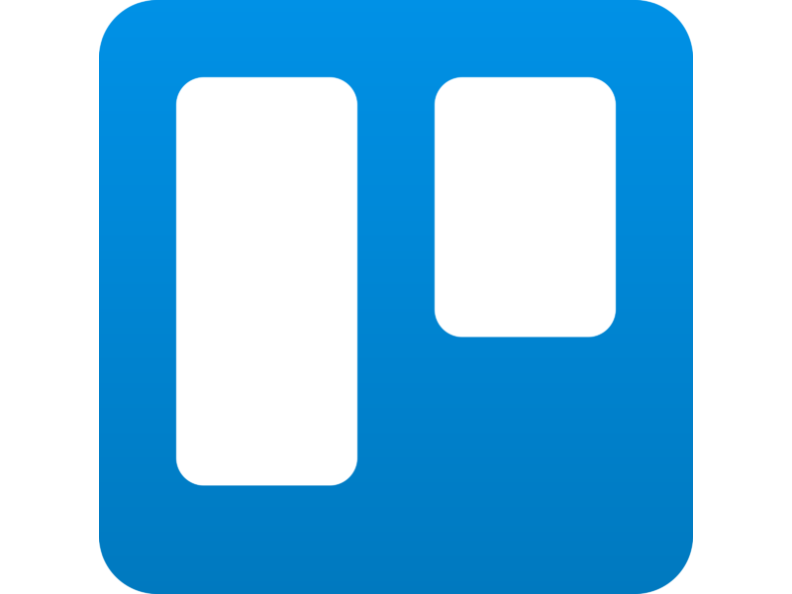
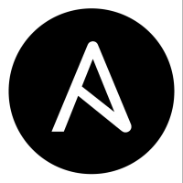







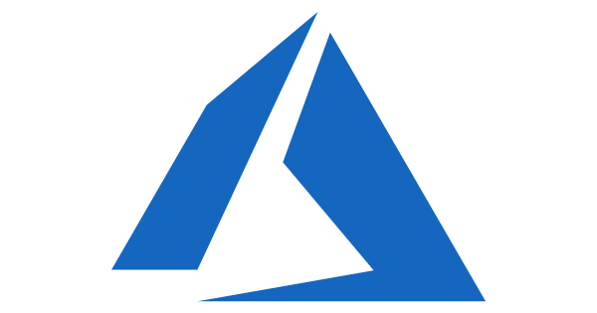
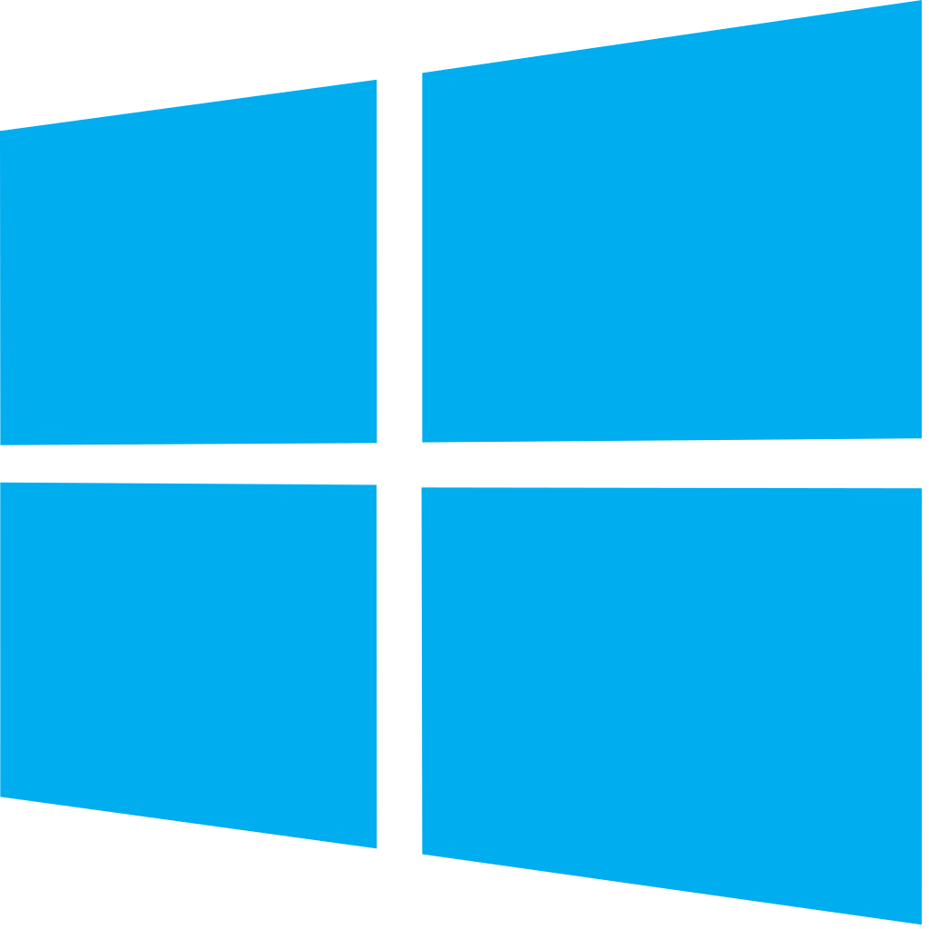
Azure DevOps: Choose what you love
Your tools, languages, and clouds
Azure DevOps lets developers choose the tools and languages that are right for them
Mix and match to create workflows with tools from Microsoft, open source or your favorite third-party tools
Target any cloud, on-prem or both and deploy to the servers you need
Notes:
You can pick and choose what you want to use and even integrate other clouds or on premise servers.

Slide 14
Azure DevOps
Azure Boards
Azure Pipelines
Azure Repos
Kanban Boards, Backlogs, Dashboards, and Reporting
CI/CD platform, FREE for open source projects
Unlimited, Cloud-Hosted Private Git Repos
Azure Test Plans
Azure Artifacts
Manual and Exploratory Testing Tools
Package Management for Maven, npm, and NuGet.
https://azure.com/devops
Notes:
There is tons of FREE in Azure DevOps to start today.

Slide 15







Your platform for building anything
Desktop
Web
Cloud
Mobile
Gaming
IoT
AI
.NET
Notes:
So that is how Xamarin as part of the .NET platform enables you to reach even more platforms than ever and share code between all of your apps.

Slide 16
Get started today
xamarin.com

Slide 17
Thank you.
Matthew Leibowitz
Software Engineer @ Microsoft
maleib@microsoft.com
dotnetdevaddict.co.za
@mattleibow

